Slide 1

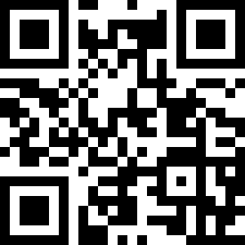

Microsoft Cloud + AI & OSS Enabling Microsoft Products and Documentation for the Community
Translate Microsoft OSS products that ship your contributions using the Microsoft Localization Community Platform https://aka.ms/msossloc
Create a free Microsoft account and begin. Vote on translations or help translate Brazilian products like VS Code, Visual Studio components, SQL for Linux, etc.
Help us improve out Brazilian Docs https://aka.ms/ms-docs
Sometimes we mess up translations! Sometimes our technical content has mistakes. You can fix them!
Use the EDIT feature on Brazilian documents https://docs.microsoft.com/pt-br/
How to contribute -> https://aka.ms/intldocs or watch the 5-min video https://www.youtube.com/watch?v=-iYVEcd_ndU&t=3s
Keep up with updates and opportunities @MicrosoftL10n

Slide 2
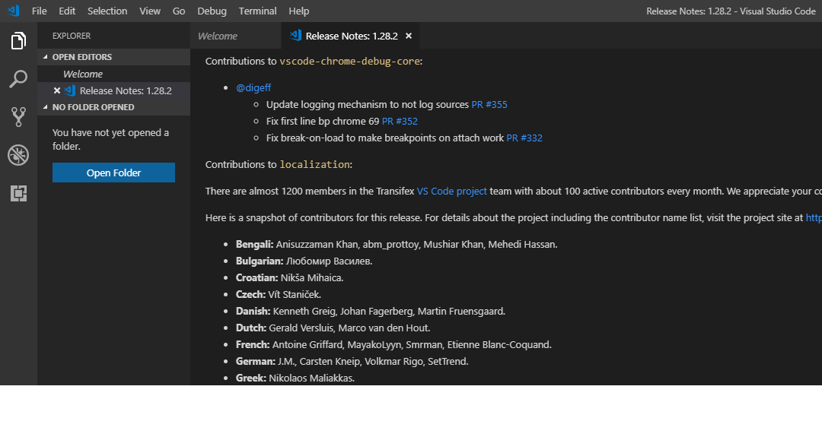
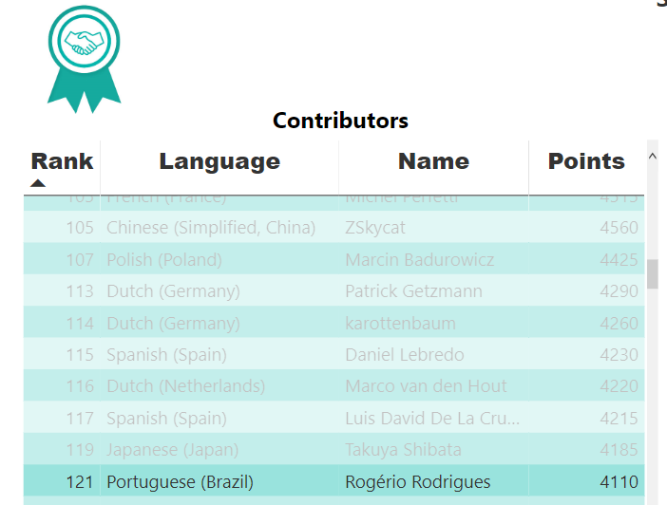
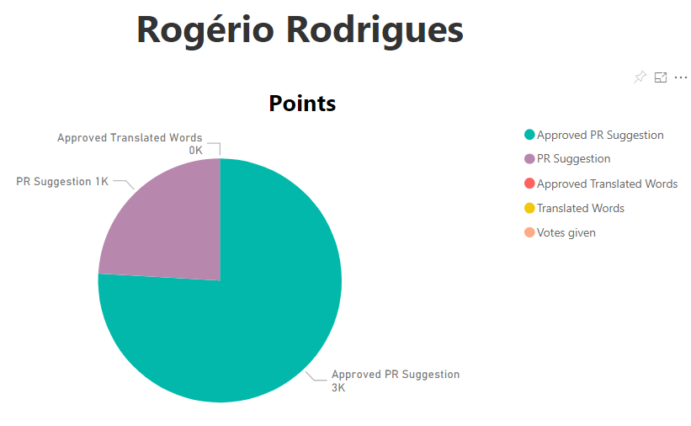
VS Code Version 1.128.2 (Ships 1/month)
Portuguese (Brazil): Roberto Fonseca, Bruno Sonnino, Danilo Dantas, Marcelo Fernandes, Thiago Custodio, Rodrigo Crespi, Marcelo Andrade, Alessandro Fragnani, Lucas Miranda, Otacilio Saraiva Maia Neto
Get your name in the Leaderboard https://microsoftl10n.github.io/
*We are adding new features to our leaderboard to showcase our community contributors

